Slide 1

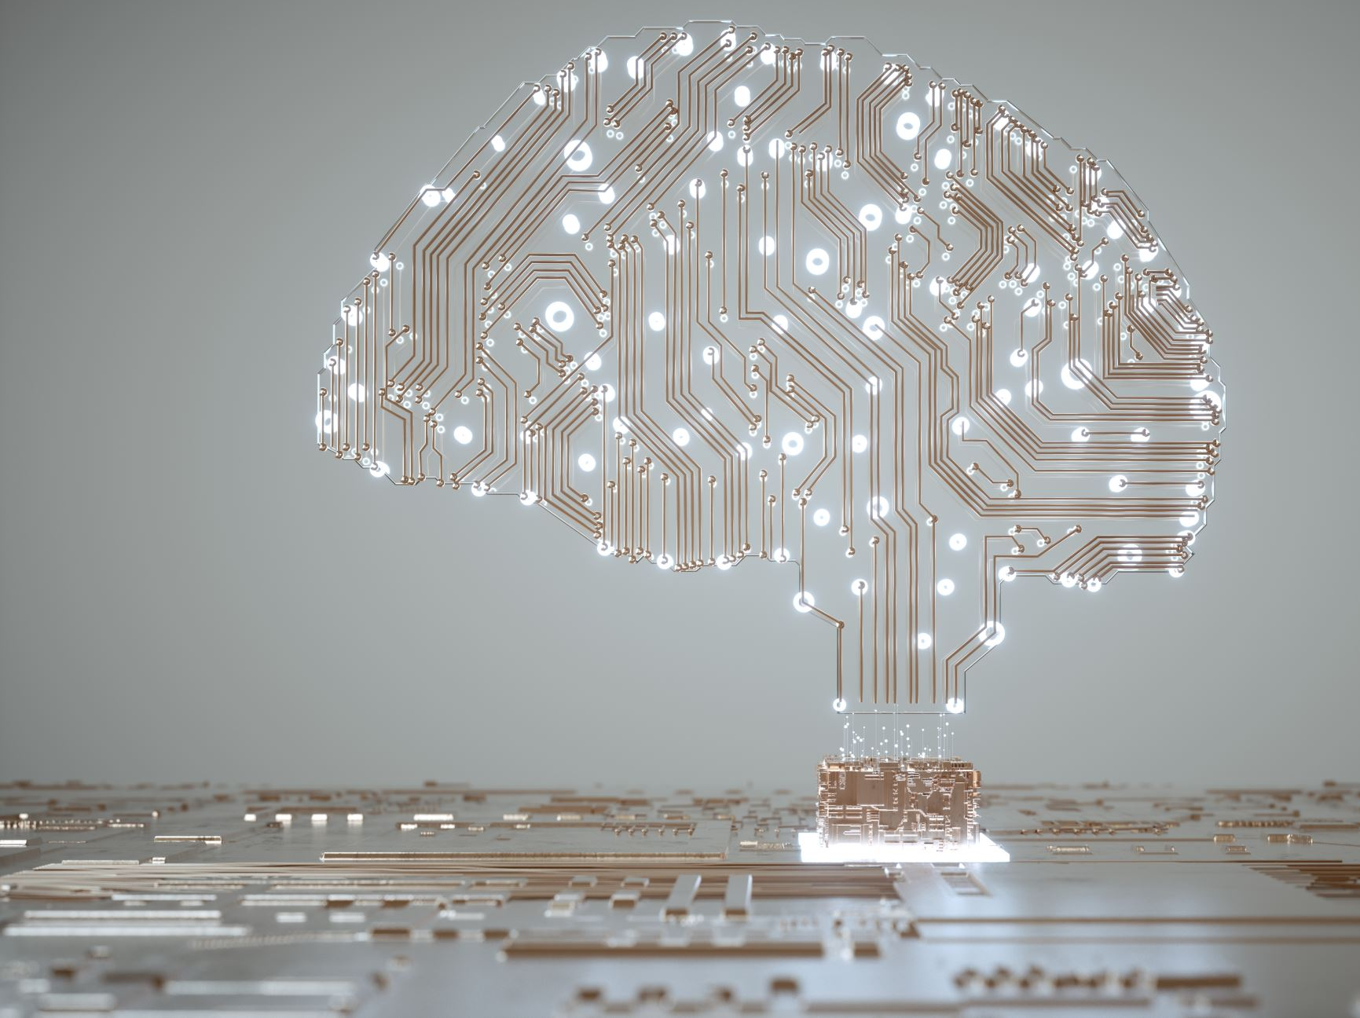
Intelligent Systems
Dr. Razuan Karim
Associate Professor
CS, FST, AIUB
rkarim@aiub.edu
Room#DN0220, Level-2
D Building

Slide 2
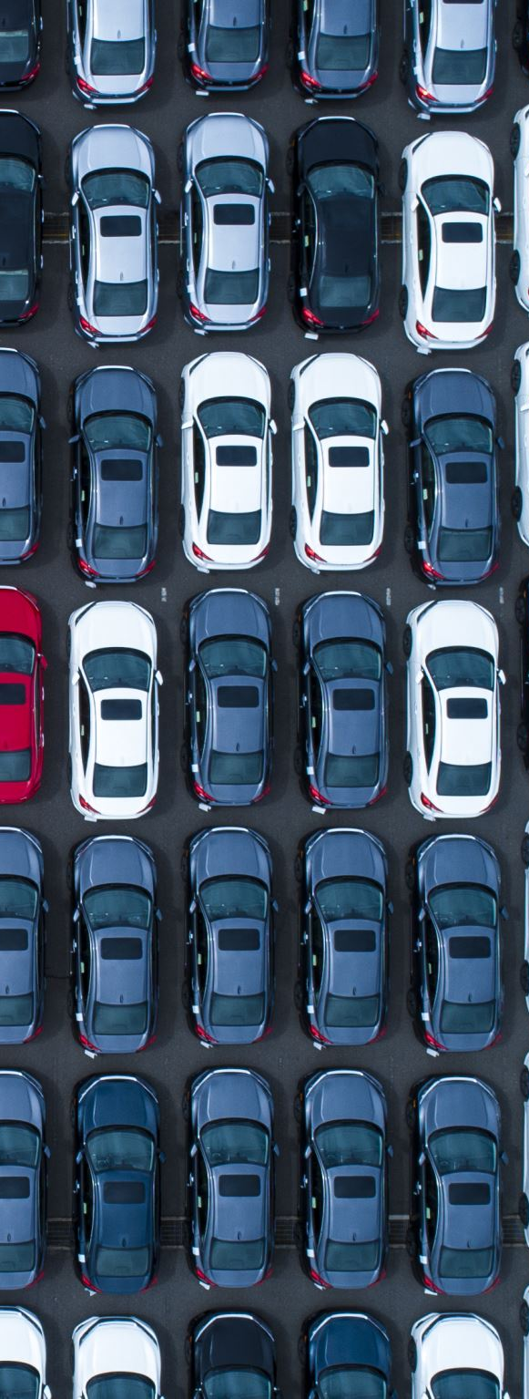
What is an Intelligent System?
Definition: A system that can perceive, reason, learn, and act.
Key Features:
- Perception
- Reasoning
- Learning
- Action
Examples: Siri, self-driving cars, recommender systems, robots
Notes:
Definition: An intelligent system is a system that can perceive, reason, learn, and act autonomously or semi-autonomously.
Key Features:
Perception: Ability to sense the environment.
Reasoning: Ability to solve problems or make decisions.
Learning: Adapting behavior based on experience.
Action: Responding with appropriate actions.
Examples:
Smart assistants (Siri, Alexa),
Self-driving cars, Recommender systems (Netflix, Amazon),
Industrial robots

Slide 3
Components of Intelligent Systems
Sensors: Collect data (e.g., camera, GPS)
Actuators: Execute actions (e.g., motors)
Knowledge Base: Stores facts/rules
Inference Engine: Applies logic
Learning Module: Learns from feedback
User Interface: Interaction with humans
Notes:
Component Description Sensors-Collect data from environment (e.g., camera, GPS), Actuators-Carry out actions (e.g., motors)
Knowledge Base-Stores rules, facts, or learned data
Inference Engine-Applies logic to derive conclusions
Learning Module-Updates knowledge based on feedback
User Interface-Enables interaction with humans

Slide 4
Types of Intelligent Systems
Reactive Systems: No memory, direct response (e.g., thermostat)
Deliberative Systems: Plan and reason (e.g., chess AI)
Hybrid Systems: Combine reactive and deliberative approaches
Notes:
Reactive Systems: No memory, Respond directly to stimuli
E.g., basic thermostat
Deliberative Systems: Use models, reasoning, planning
E.g., chess-playing software
Hybrid Systems: Combine reactive and deliberative models E.g., autonomous robots

Slide 5
Intelligent Agents
Agent: Entity that perceives and acts in an environment
Agent Architectures:
- Simple reflex agents
- Model-based agents
- Goal-based agents
- Utility-based agents
- Learning agents
Notes:
Agent: An entity that perceives and acts in an environment.
Agent Architecture:
Simple reflex agents
Model-based agents
Goal-based agents
Utility-based agents
Learning agents

Slide 6
Applications of Intelligent Systems
Healthcare: Robotic surgery, diagnosis
Education: Intelligent tutoring systems
Transportation: Autonomous vehicles
Finance: Fraud detection, prediction
Robotics: Household robots, drones
Customer Service: Chatbots, virtual agents
Notes:
Domain Example:
Healthcare-Disease prediction, robotic surgery
Education Intelligent- tutoring systems
Transportation -Autonomous vehicle
Finance-Fraud detection, stock market prediction
Robotics- Household robots, drones
Customer Service-Chatbots, virtual agents

Slide 7
Underlying Technologies
- Artificial Intelligence (AI)
- Machine Learning (ML)
- Expert Systems
- Fuzzy Logic
- Neural Networks
- Natural Language Processing (NLP)
- Computer Vision
Notes:
Artificial Intelligence (AI)
Machine Learning (ML)
Expert Systems
Fuzzy Logic
Neural Networks
Natural Language Processing (NLP)
Computer Vision

Slide 8
Machine Learning in Intelligent Systems
Types of Learning:
- Supervised Learning
- Unsupervised Learning
- Reinforcement Learning
Use Cases: Pattern recognition, prediction, adaptation
Notes:
Types of Learning:
Supervised Learning (e.g., classification)
Unsupervised Learning (e.g., clustering)
Reinforcement Learning (e.g., game AI)
ML Use Cases in IS:
Pattern recognition
Prediction
Behavior adaptation

Slide 9
Challenges in Intelligent Systems
- Knowledge acquisition
- Real-time decision making
- Uncertainty handling
- Ethical issues and bias
- Data privacy and security
Notes:
Knowledge acquisition
Real-time decision making
Uncertainty handling
Ethical issues and bias
Data privacy and security

Slide 10

Future of Intelligent Systems
- General AI (AGI)
- Emotion-aware systems
- Explainable AI
- AI for social good
- Human-AI collaboration
Notes:
General intelligence (AGI)
Emotion-aware systems
Explainable AI
AI for social good (e.g., climate modeling)
Collaborative human-AI systems

Slide 11
Summary
- Intelligent systems sense, think, learn, and act.
- Use AI technologies across various domains.
- Widely used in robotics, finance, healthcare, etc.
- Ethical and technical challenges remain.
Notes:
Intelligent systems integrate AI technologies to solve complex problems.
They can sense, think, learn, and act.
Widely used in robotics, healthcare, finance, and more.
Ethical and technical challenges remain active research areas.

